Slide 1


Module 8: Portfolio Project Oral and PowerPoint Presentation
Michelle Goodwin
Colorado State University-Global Campus
MIS 581: Capstone- Business Intelligence and Data Analytics
Dr. Osama Morad
August 4, 2024

Slide 2


Abstract
Heart disease is a disease that impacts many globally.
Objectives:
Develop predictive models to be used to identify heart disease in patients.
Analyze gender as an influencing factor in heart disease.
Analyze age impact on heart disease susceptibility.
Findings:
Effective model performance
Gender significance in heart disease
Age impacts
Notes:
This study will discuss heart disease, which impacts many globally. Heart disease remains a serious issue for many years in all regions, making it essential for focused medical research and public health initiatives.
This study will attempt to impact heart disease treatment through predictive modeling and data analytics. First, I will develop predictive models that could be used to identify heart disease patients effectively by using various predictors, such as age, sex, chest pain type, fasting blood sugar, and more. These predictors will be used to accurately predict heart disease patients. Second, I will analyze gender as a significant influencing factor in heart disease. Understanding how gender impacts heart disease risk can lead to more personalized and effective prevention strategies. Third, I will investigate the impact of heart disease susceptibility. Age is a well-known risk factor for heart disease and this analysis will provide insight into how different age groups are affected.
The findings of my research demonstrate effective performance of the predictive models in identifying individuals at risk for heart disease. This success highlights the power of data analytics in improving heart disease prediction and prevention. Additionally, the findings show that gender is a significant factor in heart disease. The data shows clear differences in how heart disease affects males and females in this dataset. Therefore, it may be beneficial to develop targeted interventions. Age is also proven as a significant factor in heart disease risk for this data sample. However, the data trends are not what we would expect, with younger individuals appearing more at risk for heart disease than older individuals. This may indicate that there are other significant factors that contribute to heart disease susceptibility.

Slide 3
Introduction
Heart disease is the leading cause of mortality globally (Di Cesare et al., 2024).
Role of data analytics in reducing heart disease mortality:
Tools for developing predictive models.
Identifying individuals at risk more effectively.
Discovering contributing factors in heart disease susceptibility.
Study focus:
Develop and evaluate predictive models
Analyze gender and age impact
Utilize UCI Heart Disease Dataset from Kaggle (Lapp, 2019).
Notes:
Heart disease is responsible for the more deaths annually than any other cause globally (Di Cesare et al., 2024). Given this alarming statistic it is essential to perform research to create effective prevention and predictive models.
Recent advances in data analytics and machine learning present increasing effective tools in developing predictive models. These models can help identify individuals who are at risk for developing heart disease. Additionally, they can uncover potential factors that contribute to heart disease susceptibility.
This study will aim to develop and evaluate predictive models for heart disease risk. Additionally, I will conduct an analysis on the impact of gender and age on heart disease susceptibility. For this purpose, I will utilize the UCI Heart Disease Dataset (Lapp, 2019).
By leveraging machine learning and data analytics, I aim to contribute valuable insight into the prediction and prevention of heart disease. An analysis of the UCI Heart Disease dataset will provide a comprehensive evaluation of the factors influencing heart disease risk, particularly focusing on gender and age differences.

Slide 4

Research Questions and Hypotheses
Can a predictive model effectively identify patients at risk for heart disease?
H₀: There is no significant relationship between the predictive model and the accuracy of identifying patients with heart disease.
H₁: There is a significant relationship between the predictive model and the accuracy of identifying patients with heart disease.
Are females or males more at risk for developing heart disease?
H₀: There is no significant relationship between gender and the risk of heart disease.
H₁: There is a significant relationship between gender and the risk of heart disease.
Is age a significant factor in heart disease?
H₀: There is no significant relationship between age and heart disease susceptibility.
H₁: There is a significant relationship between age and heart disease susceptibility.
Notes:
This study looks at three research questions that are essential for understanding and predicting heart disease risk.
The first question investigates whether a predictive model can effectively identify patients at risk for heart disease. To test this the formulated hypotheses are, there is no significant relationship between the predictive model and the accuracy of identifying patients with heart disease, for the null hypothesis, and There is a significant relationship between the predictive model and the accuracy of identifying patients with heart disease for our alternative hypothesis. To reject the null hypothesis my findings would need to indicate that my predictive model is accurate in predicting individuals at risk for heart disease.
The second research question examines whether gender plays a role in the risk of developing heart disease. To explore this, I will test the hypotheses, there is no significant relationship between gender and the risk of heart disease, as my null hypothesis. And, there is a significant relationship between gender and the risk of heart disease, as my alternative hypothesis. To reject the null hypothesis, I would need to show that male and female heart disease risk is different.
The third research question explores the impact of age on heart disease susceptibility. The hypotheses that are tested for this question are there is no significant relationship between age and heart disease susceptibility, and there is a significant relationship between age and heart disease susceptibility, as the null and alternative hypotheses respectively.

Slide 5
Literature Review
Predictive models:
Desai et al. (2019) created a logistic regression model with 92.58% accuracy and a BPNN model with 85.07% accuracy.
Al Reshan et al. (2023) developed a hybrid deep neural network model with 98.56% accuracy.
Gender-based differences
Some studies indicate men are at higher risk (Weidner, 2000); some indicate post-menopausal women are at significant risk (Regtiz-Zagrosek, 2003).
Age as a significant factor.
Farmington Heart Study shows exponential increase after age 50 (Peeters et al., 2002).
Dhingra & Vashan (2012) show age as a significant predictor, but interaction with other factors needs exploration.
Notes:
As heart disease continues to rise globally, developing effective predictive models and understanding the associated risk factors is crucial. This literature review evaluates existing research on the efficacy of predictive models and the role of gender and age in heart disease susceptibility. This review is structured around three key hypotheses focusing on the accuracy of predictive models, gender-based disparities, and age-related sustainability in relation to heart disease.
Predictive models leverage statistical techniques and machine learning algorithms to estimate a patient's likelihood of developing heart disease. Several types of models have been developed, including logistic regression, neural networks, deep learning algorithms, and hybrid models. Studies have evaluated the performance of different predictive models. Desai et al. (2019) compared backpropagation neural networks (BPNN) and logistic regression, finding higher accuracy with logistic regression at 92.58% compared to BPNN at 85.07%. Conversely, Al Reshan et al. (2023) demonstrated that a hybrid deep neural network model outperformed these, achieving 98.56% accuracy.
Gender disparities in heart disease prevalence and outcomes are well-documented. While men have traditionally been considered at higher risk (Weidner, 2000), post-menopausal women also face significant risk (Regitz-Zagrosek, 2003).
Age is a well-established risk factor for heart disease, with incidence rates increasing significantly with age. The Framingham Heart Study cohort found that heart disease risk increases exponentially with age, especially after age 50 (Peeters et al., 2002). Incorporating age into predictive models enhances their predictive power. Research by Dhingra & Vashan (2012) demonstrates that age is a significant factor in heart disease prediction. However, the interaction between age and other risk factors, such as hypertension and diabetes, needs further exploration to refine predictive accuracy.

Slide 6
Research Design and Methodology
Quantitative approach using UCI Heart Disease dataset.
Model development:
Logistic regression and Random Forest models.
Training/testing split : 60/40
Evaluation metrics: Accuracy, Precision Recall, F1 score.
Cross-Validation for robustness
Statistical tests:
Chi-square test for gender data.
T-test for mean comparison of male/female data.
Regression analysis for age impact.
Notes:
The data collection process begins with retrieving the UCI Heart Disease dataset from Kaggle. This dataset includes quantitative health metrics such as age, resting blood pressure, cholesterol, maximum heart rate, and ST depression. The dataset also includes categorical variables like gender, chest pain type, fasting blood sugar, and more. The data will be split into 60% for training and 40% for testing. A logistic regression will serve as the baseline model for predicting heart disease, and a Random forest ensemble method will also be used to improve accuracy and handle overfitting concerns. Model performance will be assessed using metrics such as accuracy, precision, recall, and F1 score. Additionally, cross-validation will be conducted to ensure robustness and generalizability.
Chi-square tests will assess associations between categorical data and heart disease risk. Additionally, T-tests will compare means between groups, such as heart disease risk between male and female patients. Lastly, regression analysis will determine the impact of age and identify significant predictors.

Slide 7

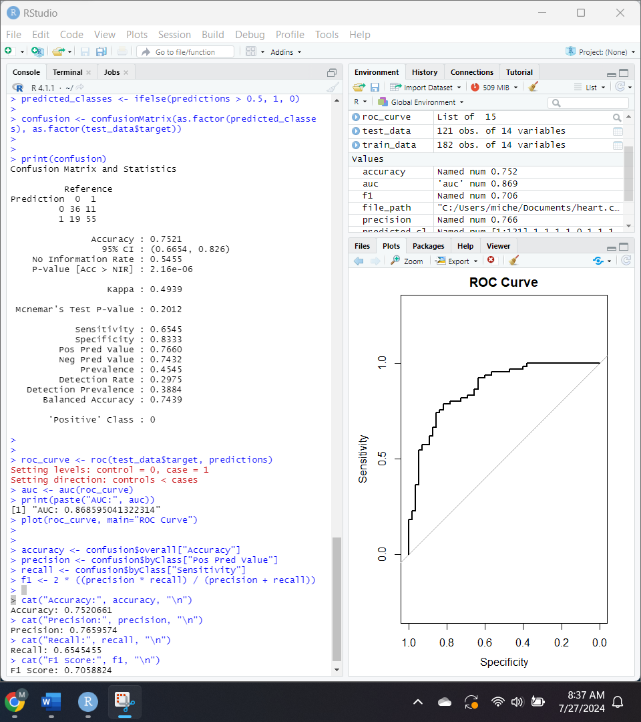
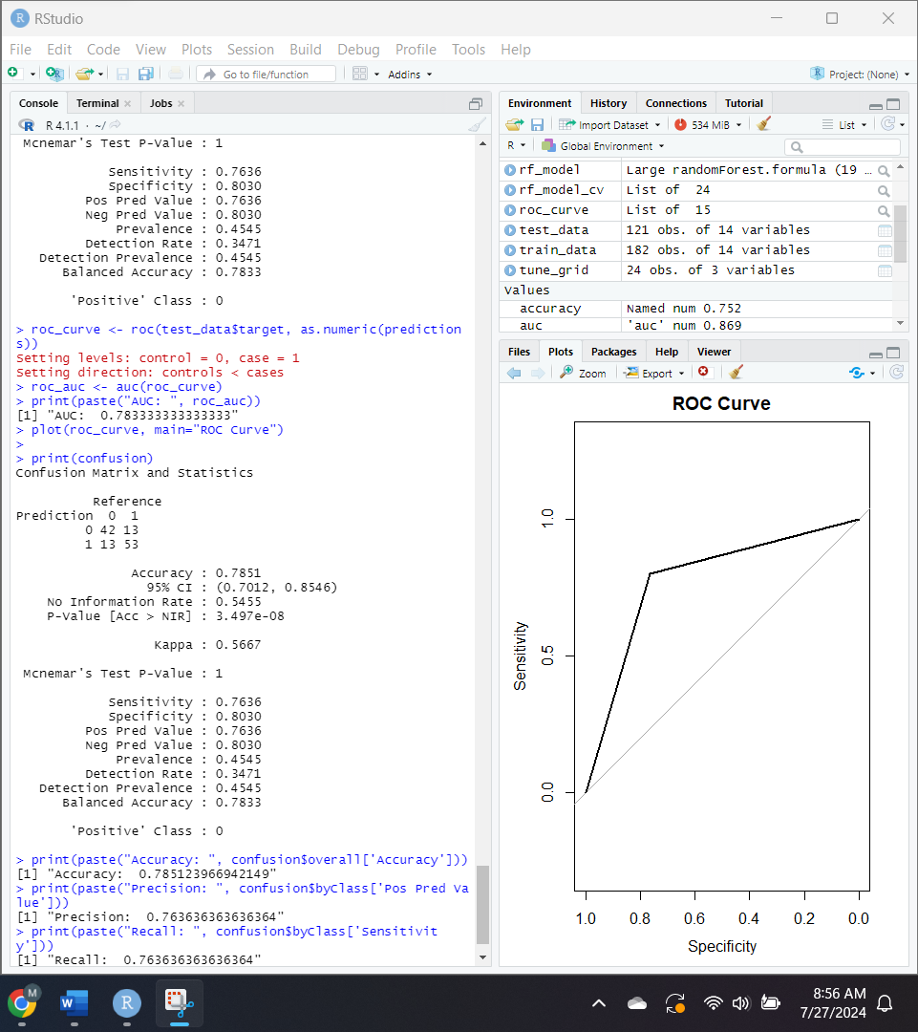
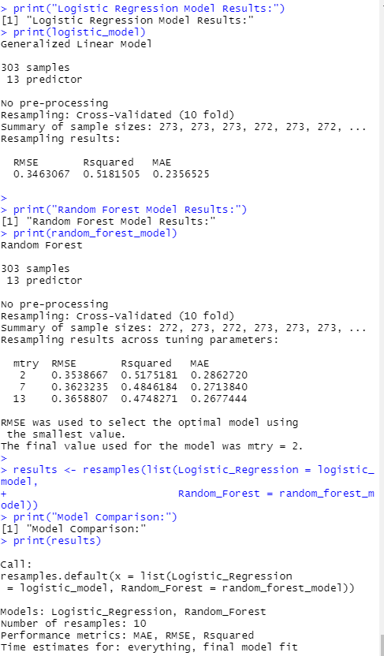
Model Evaluation and Performance
Logistic Regression:
Key influential variables: Sex, chest pain type (cp), maximum heart rate (thalach), ST depression (oldpeak), and major vessels (ca).
Metrics:
Accuracy (75.21%), sensitivity/recall (65.45%), specificity (83.33%), precision (76.60%), F1 score ( 70.59%), AUC (0.869).
Random :
Trained with 500 trees
Metrics:
Accuracy (78.51%), sensitivity/recall (76.36%), specificity (80.30%), precision (76.36%), F1 score ( 76.36%), AUC (0.783).
Cross-Validation:
Logistic regression: RMSE (0.3463), R-squared (0.5182), MAE (0.2357).
Random Forest: RMSE (0.3539), R-squared (0.5175), MAE (0.2863).
Figure 3
Figure 1
Figure 2
Cross-Validation
Logistic regression
Random Forest
Notes:
In this slide, I will discuss the evaluation and performance metrics of our predictive models: logistic regression and random forest; and; look at how well these models identify patients at risk for heart disease using various metrics.
First, the logistic regression model. This model was evaluated using several key metrics, shown in Figure 1. Significant variables include sex, chest pain type (cp), maximum heart rate achieved (thalach), ST depression induced by exercise relative to rest (oldpeak), and the number of major vessels colored by fluoroscopy (ca). The model achieved an accuracy of 75.21%, with a 95% confidence interval ranging from 66.54% to 82.60%. The sensitivity or recall was 65.45%, while the specificity was 83.33%, indicating that the model is more effective at correctly identifying true negatives than true positives. The precision, or positive predictive value, was 76.60%, and the F1 score, which balances precision and recall, was 70.59%. The area under the ROC curve (AUC) was 0.869, highlighting the model’s strong discriminatory power. These results support rejecting the null hypothesis, indicating a significant relationship between the predictive model and the accuracy of identifying patients with heart disease.
Next, we have the random forest model, trained with 500 trees, shown in Figure 2. This model achieved an accuracy of approximately 78.51% on the testing data, with a 95% confidence interval ranging from 70.12% to 85.46%. The model’s sensitivity and specificity were 76.36% and 80.30%, respectively, suggesting it performs well in correctly identifying both patients with and without heart disease. The AUC for this model was 0.783, further supporting its strong predictive power. The precision and F1 score were both 76.36%, indicating a balanced performance between precision and recall. These metrics demonstrate that the random forest model has a significant relationship with the accuracy of identifying patients with heart disease, allowing us to reject the null hypothesis.
Finally, let's look at the cross-validation results for both models, shown in Figure 3. For the logistic regression model, the RMSE was 0.3463, R-squared was 0.5182, and MAE was 0.2357. The AUC was 0.869, indicating strong discriminatory power, with a precision of 76.60% and an F1 score of 70.59%. For the random forest model, cross-validated with 10 folds, the RMSE was 0.3539, R-squared was 0.5175, and MAE was 0.2863. This model achieved an accuracy of 78.51% on the test data, with a sensitivity of 76.36% and specificity of 80.30%. Compared to logistic regression, the random forest model has slightly higher accuracy and F1 score but a marginally lower AUC, suggesting it also performs effectively in identifying patients at risk for heart disease.

Slide 8
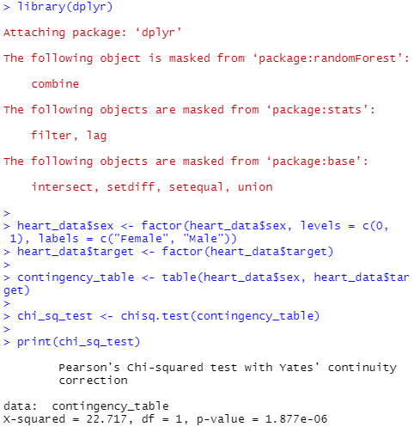
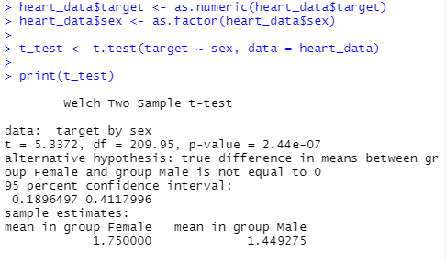
Findings on Gender
Chi-square Test
Chi-square statistic: 22.717
P-value: 1.877* 10⁻⁶
Significant relationship between gender and heart disease.
Two Sample T-test
Mean Heart risk: females (1.75), Males (1.449)
P-Value: 2.44*10⁻⁷
95% confidence interval: 0.19 to 0.41
Statistically significant difference in means
Figure 4
Chi-square Test
Figure 5
T-test
Notes:
In this slide, the significance of gender in heart disease risk is based on the analysis of the Chi-Square test and the Two Sample t-test.
First, the Chi-Square test results are shown in Figure 4. The Chi-Square statistic is 22.717, with a p-value significantly lower than 0.05. These results indicate a significant relationship between gender and heart disease risk, allowing us to reject the null hypothesis that there is no significant relationship.
Now, the Two Sample t-test results are displayed in Figure 5. The t-test reveals a statistically significant difference in mean values of heart disease risk between males and females. The mean heart disease risk for females is higher at 1.75 compared to 1.449 for males. The p-value for this test is significantly lower than 0.05, indicating a highly significant result. The 95% confidence interval for the difference in means ranges from 0.19 to 0.41, suggesting that the true difference in means lies within this range.
These findings suggest that, on average, females in this sample have a higher risk of heart disease compared to males. Therefore, the evidence strongly supports a relationship between gender and heart disease risk, with females being more at risk in this dataset. These findings align with existing literature on gender disparities in heart disease risk. However, it is important to note that other literature suggests men are generally more at risk. This discrepancy could be due to underreporting of heart disease in females or the specific characteristics of this dataset, which may include more post-menopausal women. Further evaluation is needed for a more accurate and comprehensive understanding of gender disparities in heart disease risk.

Slide 9
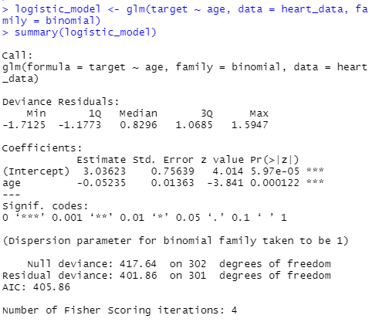
Findings on Age
Logistic regression of age and heart disease:
Age coefficient (-0.05235), p-value (0.000122), Reduction in deviance (417.64 to 401.86)
Figure 6
Logistic Regression with Age
Notes:
In this slide, the results of our logistic regression analysis examines the relationship between age and the risk of heart disease.
The logistic regression analysis, as shown in Figure 6, reveals that age is a statistically significant factor influencing the risk of heart disease. Interestingly, the model shows a negative coefficient for age (-0.05235), which indicates that with each additional year of age, the log odds of developing heart disease actually decrease. This finding is somewhat surprising and contrary to common expectations, as previous research typically suggests that heart disease risk increases with age. The statistical significance of this finding is supported by a highly significant p-value of 0.000122, which is much lower than the conventional threshold of 0.05. This indicates that the observed relationship between age and heart disease risk is unlikely to be due to random chance. The fit of the logistic regression model is robust, as evidenced by the reduction in deviance from the null model and a low Akaike Information Criterion (AIC) value. The null deviance, which measures the fit of a model with no predictors, is 417.64.When age is included as a predictor, the residual deviance decreases to 401.86, signifying an improved fit.“
Based on these results, we can reject the null hypothesis (H0), indicating that there is a significant relationship between age and heart disease susceptibility. However, it is important to note that these results are the opposite of what previous research may suggest, which typically finds that heart disease risk increases with age. This discrepancy indicates that the model may need to include more variables to more accurately capture the factors influencing heart disease risk. While age is a significant predictor in our model, further research is needed to understand the full range of variables that contribute to heart disease risk

Slide 10
Conclusion
Predictive Models
Both models are effective in identifying heart disease risk.
Logistic regression outperforms random forest in discriminatory ability (AUC).
Gender and Heart Disease
Significant relationship
Females show higher average risk level.
Age as a Predictor
Significant logistic regression model
Contradictory to previous findings, suggesting a complexity of risk factors.
Notes:
In summary, a comparative analysis of the logistic regression and random forest models in predicting heart disease risk determined both models have shown significant capabilities in identifying patients at risk. The logistic regression model achieved an accuracy of 75.21% and an Area Under the Curve (AUC) of 0.869. The AUC is particularly important as it measures the model's ability to distinguish between patients with and without heart disease. On the other hand, the random forest model achieved a slightly higher accuracy of 78.51% but a lower AUC of 0.783 compared to logistic regression. Both models are effective in distinguishing between patients with and without heart disease, demonstrating their utility in predictive analytics. However, logistic regression slightly outperforms random forest in terms of discriminatory ability, as indicated by the higher AUC. This suggests that logistic regression is better at correctly identifying true positives and true negatives.
The statistical tests conducted confirm a significant relationship between gender and heart disease risk. Females in the dataset showed higher average risk levels than males. This finding aligns with existing literature but also raises the possibility of underreporting in females or specific characteristics of the dataset influencing these results.
Age was identified as a significant predictor in the logistic regression model. Interestingly, our analysis found a negative coefficient for age, contrary to previous research which generally indicates an increased risk with age. This unexpected result highlights the complexity of heart disease risk factors and suggests that other variables might need to be included to more accurately capture the true risk.

Slide 11
Recommendations
Utilize multiple models:
1
Logistic regression model shows strong discriminatory power, while random forest shows higher accuracy.
Further research:
2
Include additional variables and perform further research on age and gender disparities.
Utilize other datasets:
3
Include data on more diverse populations with extensive demographic information
Investigate Underreporting
4
Post-menopausal impact on female heart disease risk.
Notes:
Based on my analysis of logistic regression and random forest models in predicting heart disease risk, we have several recommendations and suggestions for future research. I recommend utilizing both logistic regression and random forest models in conjunction to leverage their respective strengths. Logistic regression provides strong discriminatory power, making it effective for distinguishing between patients with and without heart disease. The random forest model, on the other hand, has a higher practical accuracy, which makes it valuable for real-world applications.
Further research should focus on exploring the potential for including additional variables or refining current predictors to better capture heart disease risk. Special attention should be given to age and gender disparities, as our findings indicate these factors play a significant role in heart disease risk.
To validate our findings and ensure robust, generalizable results, I recommend using a more comprehensive dataset. This dataset should include diverse populations and more extensive demographic information to provide a broader perspective on heart disease risk factors.
Future studies should investigate the potential underreporting of heart disease risk in females. Additionally, examining the impact of post-menopausal status on heart disease risk is crucial to understand how it influences risk levels among women.

Slide 12
References
Al Reshan, M. S., Amin, S., Zeb, M. A., Sulaiman, A., Alshahrani, H., & Shaikh, A. (2023). A robust heart disease prediction system using hybrid deep neural networks. IEEE Access.
Desai, S. D., Giraddi, S., Narayankar, P., Pudakalakatti, N. R., & Sulegaon, S. (2019). Back-propagation neural network versus logistic regression in heart disease classification. In Advanced Computing and Communication Technologies: Proceedings of the 11th ICACCT 2018 (pp. 133-144). Springer Singapore.
Dhingra, R., & Vasan, R. S. (2012). Age as a risk factor. Medical Clinics, 96(1), 87-91.
Di Cesare, M., Perel, P., Taylor, S., Kabudula, C., Bixby, H., Gaziano, T. A., ... & Pinto, F. J. (2024). The heart of the world. Global heart, 19(1).
Lapp, D. (2019, June 6). Heart disease dataset. Kaggle.
Peeters, A., Mamun, A. A., Willekens, F., & Bonneux, L. (2002). A cardiovascular life history. European heart journal, 23(6), 458-466.
Regitz-Zagrosek, V. (2003). Cardiovascular disease in postmenopausal women. Climacteric, 6, 13.
Weidner, G. (2000). Why do men get more heart disease than women? An international perspective. Journal of American College Health, 48(6), 291-294.

